Slide 1


06 May, 2024
SALES
ANALYSIS
REPORT
Prajakta Kadu

Slide 2

This report provides a detailed analysis of e-commerce sales data to understand customer segments, order priorities, Profit and sales distribution across various product categories and sub-categories. The goal is to derive actionable insights to inform strategic decision-making, enhance customer satisfaction, and optimize sales performance.
Introduction

Slide 3
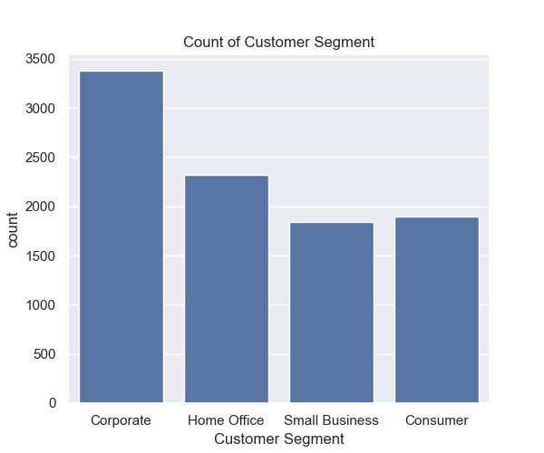
Customer Segment Analysis
The sales report reveals a Corporate customers form the majority of the customer base, indicating a focus on large-scale orders or B2B transactions.
The Home Office segment follows, with Small Business and Consumer segments having comparable but lower counts.
This analysis will provide valuable insights for targeted marketing efforts, allowing us to tailor strategies to specific customer segments and enhance overall engagement and conversion rates.

Slide 4
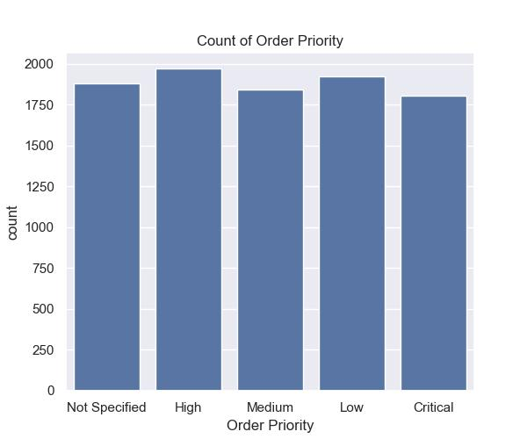
Order Priority Analysis
Order priorities are fairly balanced across Not Specified, High, Medium, Low, and Critical categories. High-priority orders have a slight edge, suggesting a tendency towards expedited order handling.
Maintain a balanced approach to managing order priorities while ensuring high-priority orders are handled efficiently to meet customer expectations.

Slide 5
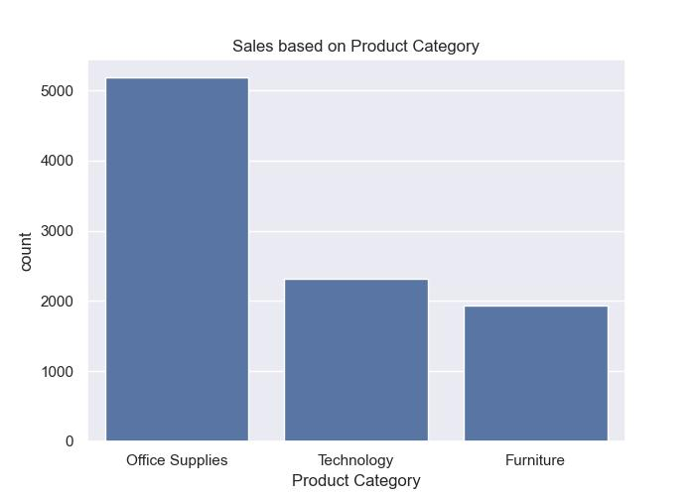
Product Category Sales Analysis
Office supplies are the top-selling product category, highlighting the primary focus of sales. Technology and furniture, while important, are secondary in terms of sales volume.
Focus on maintaining a robust inventory and competitive pricing for office supplies to sustain and grow this revenue stream.

Slide 6
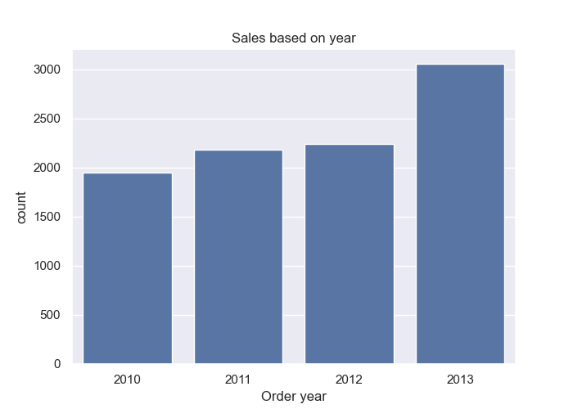
Sales Goals Report
The bar chart shows that the overall sales trend from 2010 to 2013. As observed, there is a consistent upward trend in sales over these years."
Our sales efforts have yielded a commendable increase in revenue compared to the previous period, showcasing robust growth in product sales and signaling the success of our sales strategies and the market reception of our products.

Slide 7
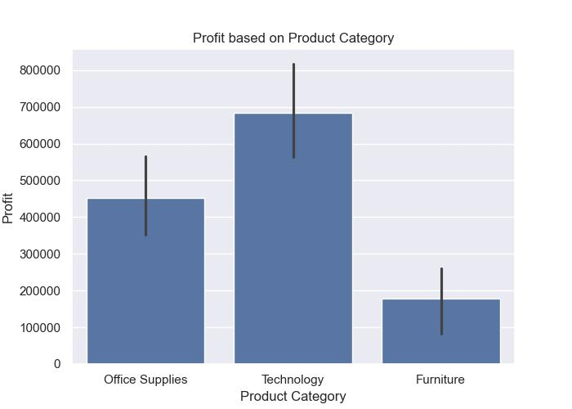
Profit Distribution by Product Category
Technology generate the highest profit to the overall profit even though Office Supplies is top-selling product.
Furniture has the lowest profit margin. Factors contributing to this include high production costs and lower sales volume compared to other categories.

Slide 8
This e-commerce sales data analysis provides valuable insights into customer segments, order priorities, and product sales and profit distribution. By focusing on the identified key areas and implementing the recommended strategies, the business can enhance its sales performance, improve customer satisfaction, and achieve sustainable growth.
Conclusion

Slide 9
Thank You

